Slide 1
Book information and repository system

Slide 2
Abstract
Using this application the Customers can buy the books using internet by sitting at home. Usually the book reader if they want to buy a book they should visit the book stalls, go through the book contents and they wish to purchase the book they does the payment and gets the book to the home. To overcome this manual visit to the book stalls we can use this application to visit the book stalls virtually and make the payment of purchase.

Slide 3
Contents
Abstract
Introduction
Existing System
Proposed System
Modules
System Configuration & Hard Ware Configuration
Model Analysis
System architecture
Uml Diagrams

Slide 4
PROBLEM IN EXISTING SYSTEM
The existing system is a manual system. In this system user needs to save his information in the form of excel sheets or Disk Drives.
There is no sharing is possible if the data is in the form of paper or Disk drives.
The manual system gives us very less security for saving data; some data may be lost due to mismanagement.
There is no rich user interface.
In this system user manually visit the book stalls to buy the books.
Searching of particular information is very critical it takes lot of time.
There is no communication facility between users of this system.
The users cannot able to restrict the information.
There is no report generation.

Slide 5
PURPOSE OF THE PROJECT
The project is fully integrated with Customer Relationship Management (CRM) solution and developed in a manner that is easily manageable, time saving and relieving one form semi automated.
Using this application the Customers can buy the books using internet by sitting at home. Usually the book reader if they want to buy a book they should visit the book stalls, go through the book contents and they wish to purchase the book they does the payment and gets the book to the home. To overcome this manual visit to the book stalls we can use this application to visit the book stalls virtually and make the payment of purchase.
In this system an Administrator is going to add a New Book details like ISBN Code, Book Name, Author, Publisher details into the system based on its Category, etc. The Administrator will receive the request from the Customer as Purchase of a book. The Administrator will receive the payment from Customer for the delivery of the book through Credit Card and reserves the book for the Customer. Using the Courier delivery system the Administrator dispatches the book to the Customer.

Slide 6
Modules:
Administrator
Customers
General Users
Web Registration
Search
Buy
Authentication

Slide 7
SOLUTION OF THESE PROBLEMS
The development of the new system objective is to address the solutions for the drawbacks of existing problem domain.
The development of this new system contains the following activities, which try to automate the entire process keeping in the view of database integration approach.
User Friendliness is provided in the application with various controls provided by system Rich User Interface.
The system makes the overall project management much easier and flexible.
It can be accessed over the Intranet.
It provides email facility between users of this system.
The customers, orders and books information files can be stored in centralized database which can be maintained by the system.
In this system customer can visit the book stalls virtually and select the books.
Authentication is provided for this application only registered users can access.

Slide 8
Hardware Specification:
S.NO | HARDWARE | CONFIGURATIONS
1 | Operating System | Windows 7 or above
2 | RAM | 2GB
3 | Processor (with Speed) | Intel Pentium IV (3.0 GHz) and Upwards
4 | Hard Disk Size | 40 GB and above
5 | Monitor | 15’ CRT

Slide 9
Software specification
S.NO | SOFTWARE | CONFIGURATIONS
1 | Techonology | Python
2 | Framework | Django
 | Front-end framework | Bootstrap
3 | Front End | Html, CSS, Java script
4 | Back End | Db sqlite3

Slide 10
System Anlaysis:
Software development of life cycle (SDLC) as it describes the complete requirement of the system. It means for use by developers and will be the basic during testing phase. Any changes made to the requirements in the future will have to go through formal change approval process.

Slide 11
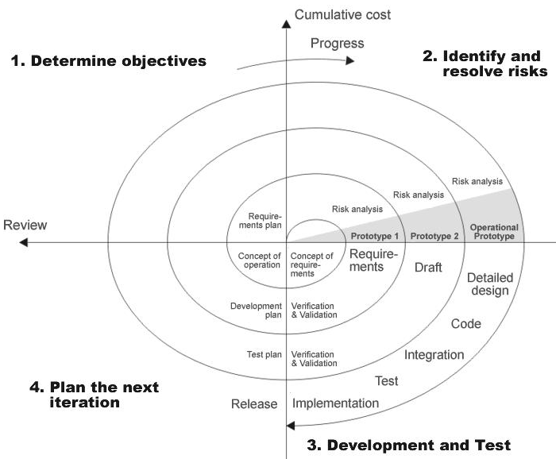
Spiral Model:

Slide 12
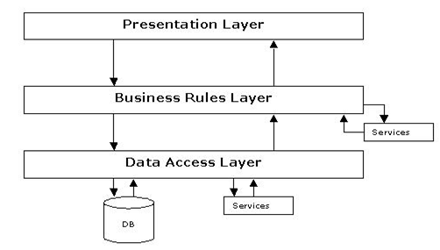
Architecture:

Slide 13
UML
UML DIAGRAMS
The Unified Modeling Language (UML) is used to specify, visualize, modify, construct and document the artifacts of an object-oriented software intensive system under development. UML offers a standard way to visualize a system's architectural blueprints, including elements such as:
actors
business processes
(logical) components
activities
programming language statements
database schemas, and
Reusable software components.

Slide 14
Usecase Diagram(USER)

Slide 15
Usecase (admin)

Slide 16
Class Diagram

Slide 17
Class Diagram(admin)

Slide 18
Sequence(User)

Slide 19
Activity(User)

Slide 20
Activity (admin)

Slide 21
Sequence(admin)

Slide 22
Statechart(User)

Slide 23
Usecase(Admin)

Slide 24
Conclusion
Here we conclude that this project contains the features what we shown in the Design document. Further we will be moving for development of application.

Slide 25
Reference
Books:
Python: Python crash course.
Django: A django by example.
Online resources:
https://www.djangoproject.com/

Slide 26
Future Work
The present work solves the problem of creating a marketplace to buying and selling a book online. For future work there is a scope where one can sell e-books also using this kind of systems with few enhancements.

